Slide 1



Lecture 2b
Multi-Layer Perceptrons (MLP)
Master in Big Data Solutions 2020-2021 - Artificial Intelligence
Xavier Giró
xavier.giro@bts.tech

Slide 2






Acknowledgements
Kevin McGuinness
kevin.mcguinness@dcu.ie
Eva Mohedano
eva.mohedano@insight-centre.org
Research Fellow
Insight Centre for Data Analytics
Dublin City University
Postdoctoral Researcher
Insight Centre for Data Analytics
Dublin City University
Elisa Sayrol
elisa.sayrol@upc.edu
Antonio Bonafonte
antonio.bonafonte@upc.edu
Associate Professor
ETSETB TelecomBCN
Universitat Politècnica de Catalunya
Associate Professor
ETSETB TelecomBCN
Universitat Politècnica de Catalunya

Slide 3
Overview
Limitations the perceptron
Multilayer perceptrons
Implementation details

Slide 4
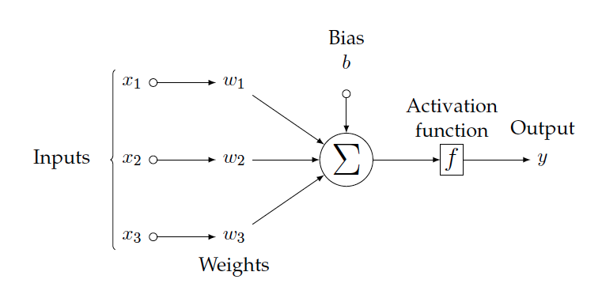
Single Neuron
If the weighted sum of the input exceeds a threshold the neuron fires a signal.
Binary Classification task
Decision boundary can be calculated by:
w₁x₁ + w₂x₂ +w₃x₃ +b=0
Notes:
Biological n.

Slide 5
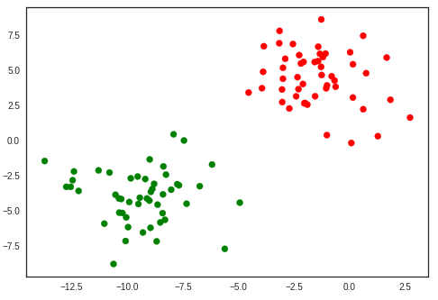
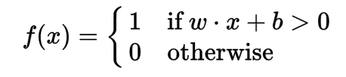
Linear decision decision boundary
2D input space data
x
Class 0
Class 1
x₂
x₁

Slide 6
The XOR problem
Limitation: Data might be non linearly separable
→ One single neuron is not enough
XOR logic table
Input 1 | Input 2 | Desired Output
0 | 0 | 0
0 | 1 | 1
1 | 0 | 1
1 | 1 | 0
Input 2
1
?
0
0
1
Input 1

Slide 7
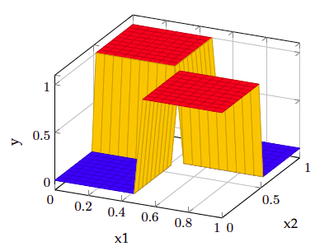
The XOR problem
Limitation: Data might be non linearly separable
→ One single neuron is not enough
Input 2
1
?
Input 1
0
0
1

Slide 8
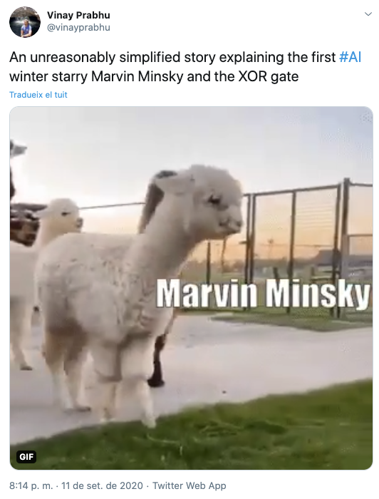
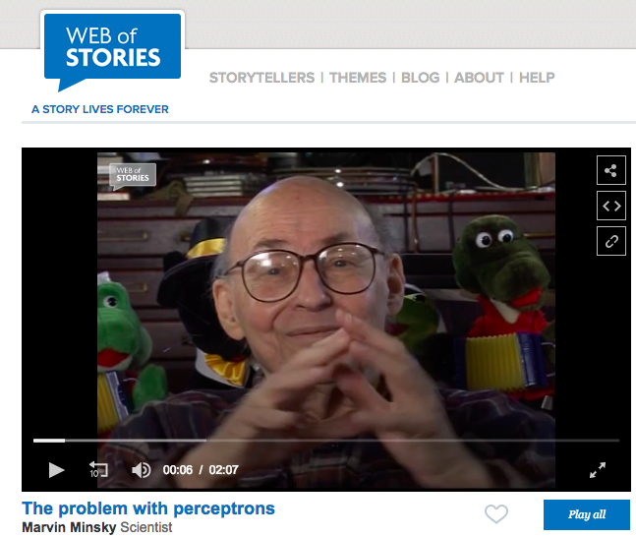

Minsky, Marvin, and Seymour A. Papert. Perceptrons: An introduction to computational geometry. 1969

Slide 9
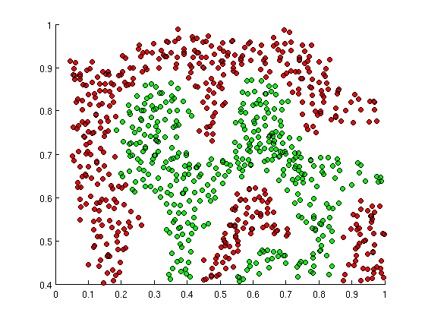
Non-linear decision boundaries
Linear models can only produce linear decision boundaries
Real world data often needs a non-linear decision boundary
Images
Audio
Text

Slide 10
Non-linear decision boundaries
What can we do?
Use a non-linear classifier
Decision trees (and forests)
K nearest neighbours
Engineer a suitable representation
One in which features are more linearly separable
Then use a linear model
Engineer a kernel
Design a kernel K(x₁, x₂)
Use kernel methods (e.g. SVM)
Learn a suitable representation space from the data
Deep learning, deep neural networks
Boosted cascade classifiers like Viola Jones also take this approach

Slide 11
Non-linear decision boundaries
What can we do?
Use a non-linear classifier
Decision trees (and forests)
K nearest neighbours
Engineer a suitable representation
One in which features are more linearly separable
Then use a linear model
Engineer a kernel
Design a kernel K(x₁, x₂)
Use kernel methods (e.g. SVM)
Learn a suitable representation space from the data
Deep learning, deep neural networks
Boosted cascade classifiers like Viola Jones also take this approach

Slide 12
Overview
Limitations the perceptron
Multilayer Perceptrons
Implementation details

Slide 13
Multilayer Perceptrons - MLPs
Fully connected network
h₃
y₁
y₂
Layer 3
When each node in each layer is a linear combination of all inputs from the previous layer then the network is called a multilayer perceptron (MLP)
Weights can be organized into matrices.
h₂
Layer 2
Forward pass computes
h₁
Layer 1
h₀
x₁
x₂
x₃
x₄
Layer 0

Slide 14
Multilayer Perceptrons - MLPs
W₁
h₀
b₁
h₃
y₁
y₂
Layer 3
h₁₁= g( wx +b )
w₁₁ | w₁₂ | w₁₃ | w₁₄
w₂₁ | w₂₂ | w₂₃ | w₂₄
w₃₁ | w₃₂ | w₃₃ | w₃₄
w₄₁ | w₄₂ | w₄₃ | w₄₄
x₁
x₂
x₃
x₄
b₁
b₂
b₃
b₄
h₂
Layer 2
Forward pass computes
h₁
Layer 1
h₀
x₁
x₂
x₃
x₄
Layer 0

Slide 15
Multilayer Perceptrons - MLPs
W₁
h₀
b₁
h₃
y₁
y₂
Layer 3
h₁₁= g( wx +b )
w₁₁ | w₁₂ | w₁₃ | w₁₄
w₂₁ | w₂₂ | w₂₃ | w₂₄
w₃₁ | w₃₂ | w₃₃ | w₃₄
w₄₁ | w₄₂ | w₄₃ | w₄₄
x₁
x₂
x₃
x₄
b₁
b₂
b₃
b₄
h₁₂= g( wx +b )
h₂
Layer 2
Forward pass computes
h₁
Layer 1
h₀
x₁
x₂
x₃
x₄
Layer 0

Slide 16
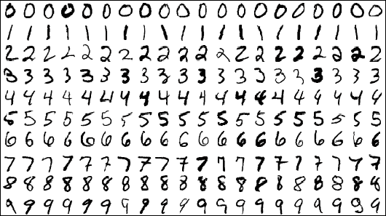
Task: MNIST digit classification
MNIST
Popular dataset of handwritten digits
60,000 training examples
10,000 test examples
10 classes (digits 0-9)
28x28 grayscale images (784D)
Objective
Learn a function y = f(x) that predicts the digit from the image
Measure accuracy on test set

Slide 17

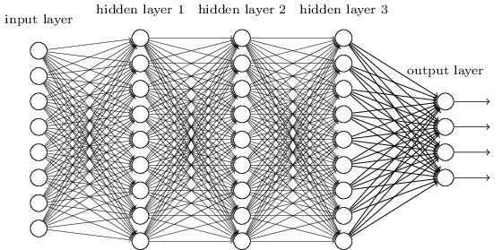
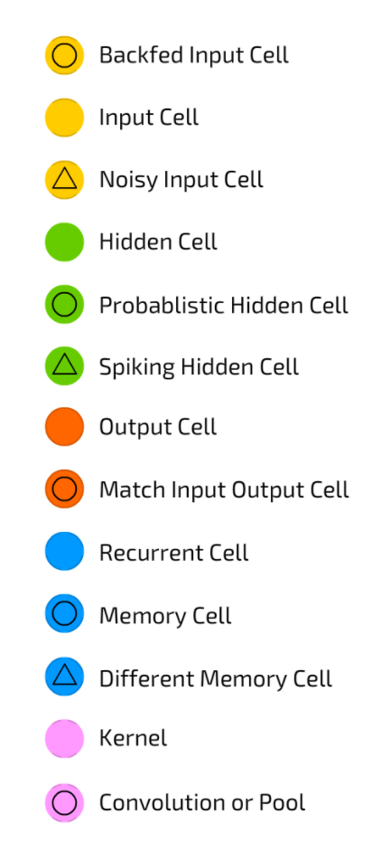
Deep Neural Networks (DNN)
DEEP = Hierarchy of concepts
(eg. AlexNet = 8 layers)
F. Van Veen, “The Neural Network Zoo” (2016)

Slide 18
Backpropagation across layers
Gradients can flow across stacked layers of neurons to estimate their parameters.
Backward pass

Slide 19

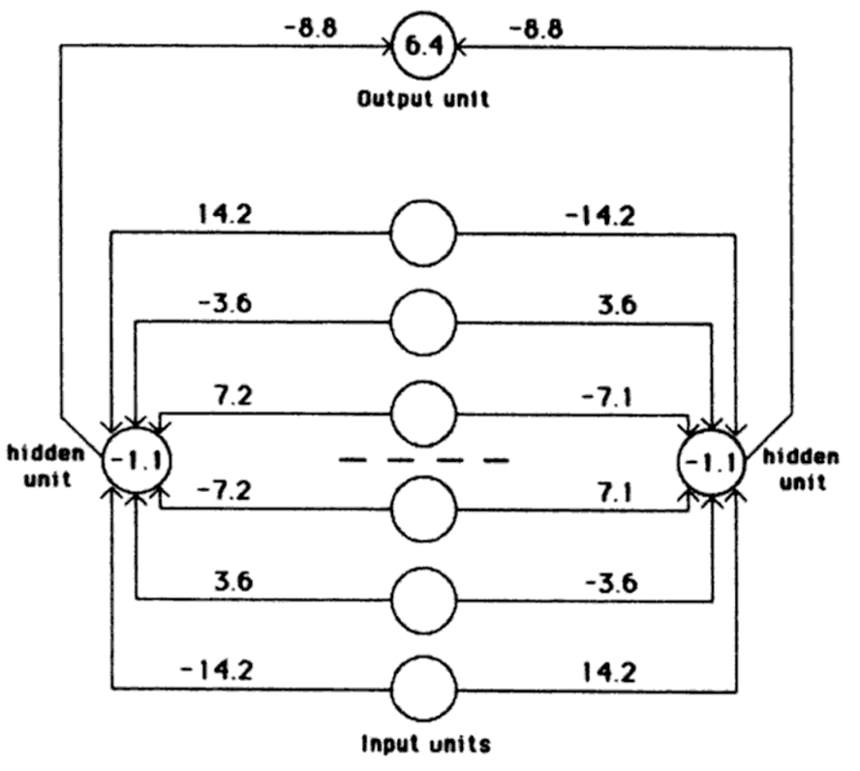
Backpropagation across layers
Rumelhart, David E., Geoffrey E. Hinton, and Ronald J. Williams. "Learning representations by back-propagating errors." Cognitive modeling 5, no. 3 (1988).

Slide 20
Overview
Limitations the perceptron
Multilayer Perceptrons
Implementation details

Slide 21
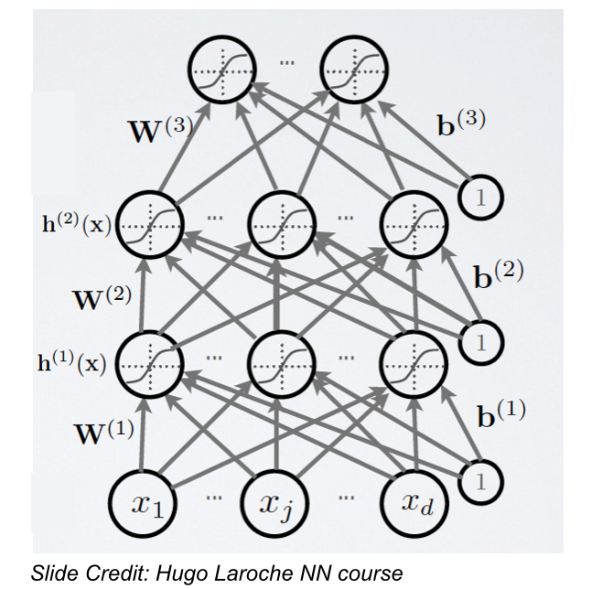

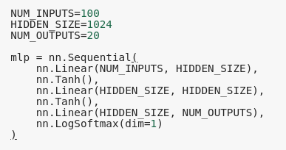
Software implementation

Slide 22
Overview
Limitations the perceptron
Multilayer Perceptrons
Implementation details

Slide 23


